Slide 1
Using Bayesian Regression Techniques to Quantify Complex Interactions
Elizabeth Zhang
Advisor: Amy Wagaman

Slide 2
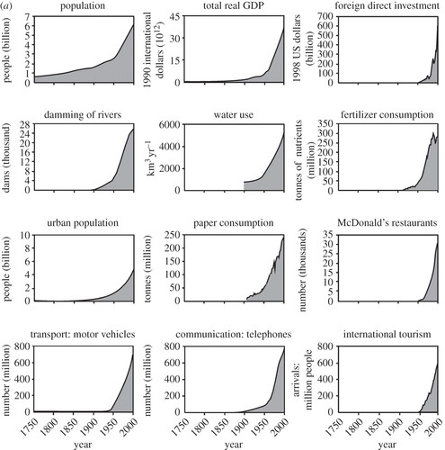
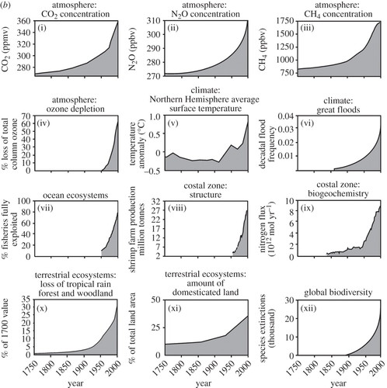
Social and environmental conditions
Notes:
Define Anthropocene
Environmental conditions have been rapidly changing since ~1950 (the great acceleration)
How do we navigate our relationship with the environment amidst such changes

Slide 3
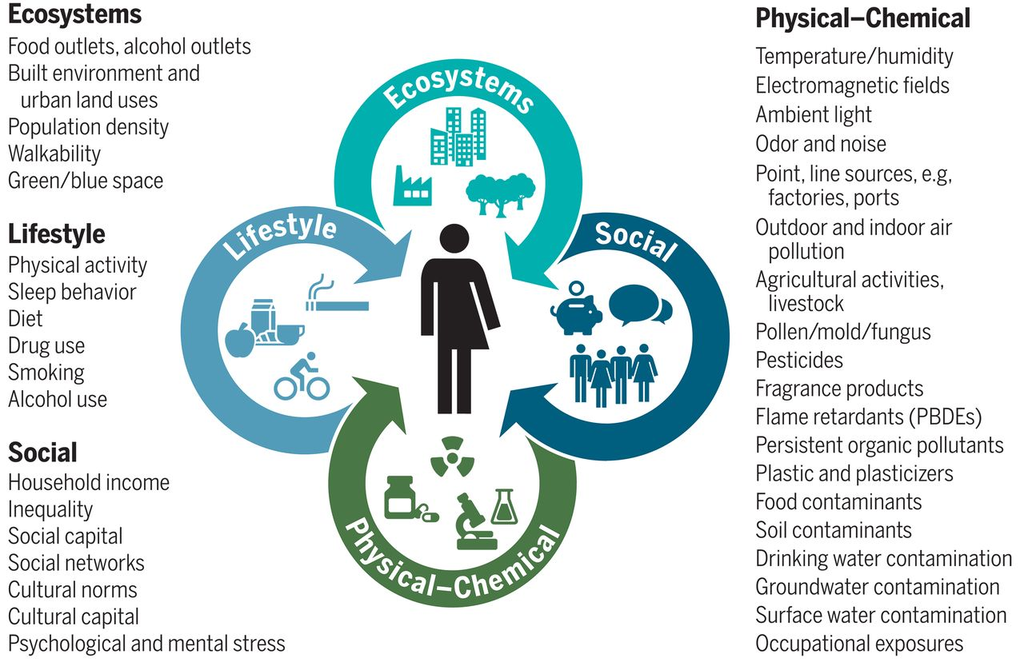
Exposomic view of health
Notes:
In response to changing environment, scholars have developed the concept of the exposome
Health outcomes are shaped by a complex mix of genetic and ecosystem, lifestyle, etc.
Preventive epidemiology: identify these risk factors
Subset we are interested in: physical-chemical risk factors, particularly, toxic exposures

Slide 4
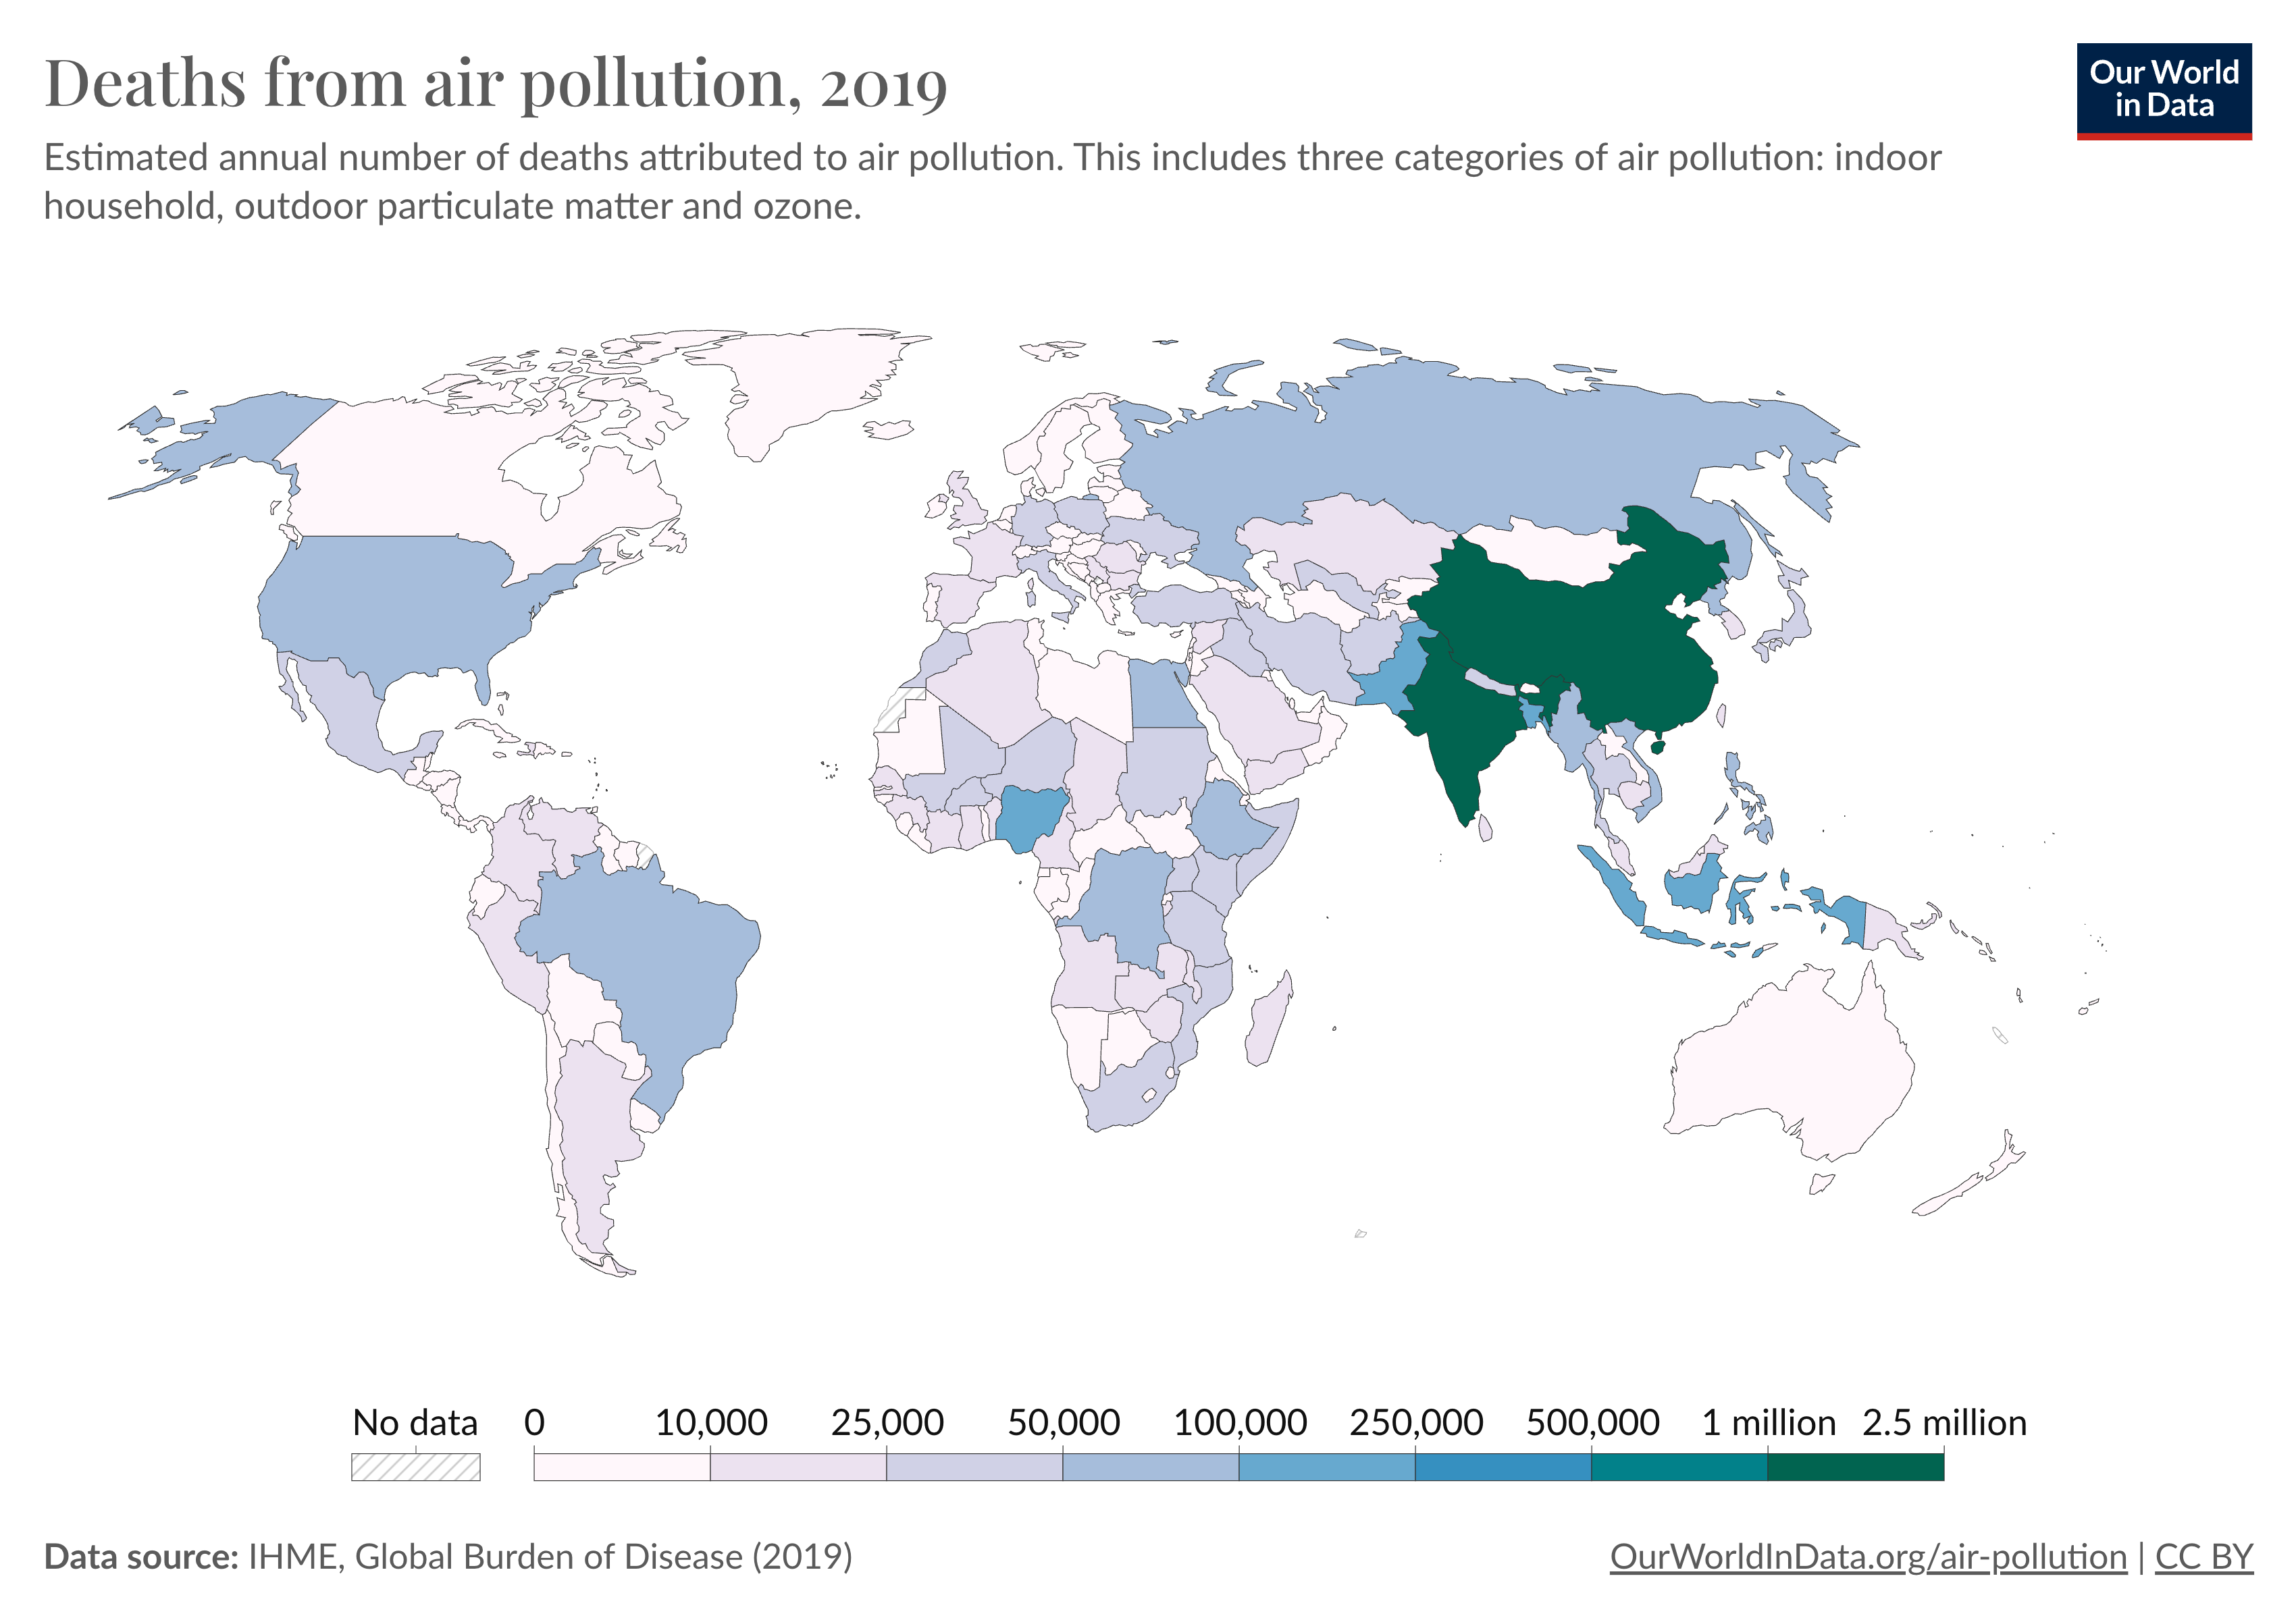
Global burden of air pollution
Notes:
Consider air pollution
The effects of pollution are felt unequally
Pressing global health crisis

Slide 5
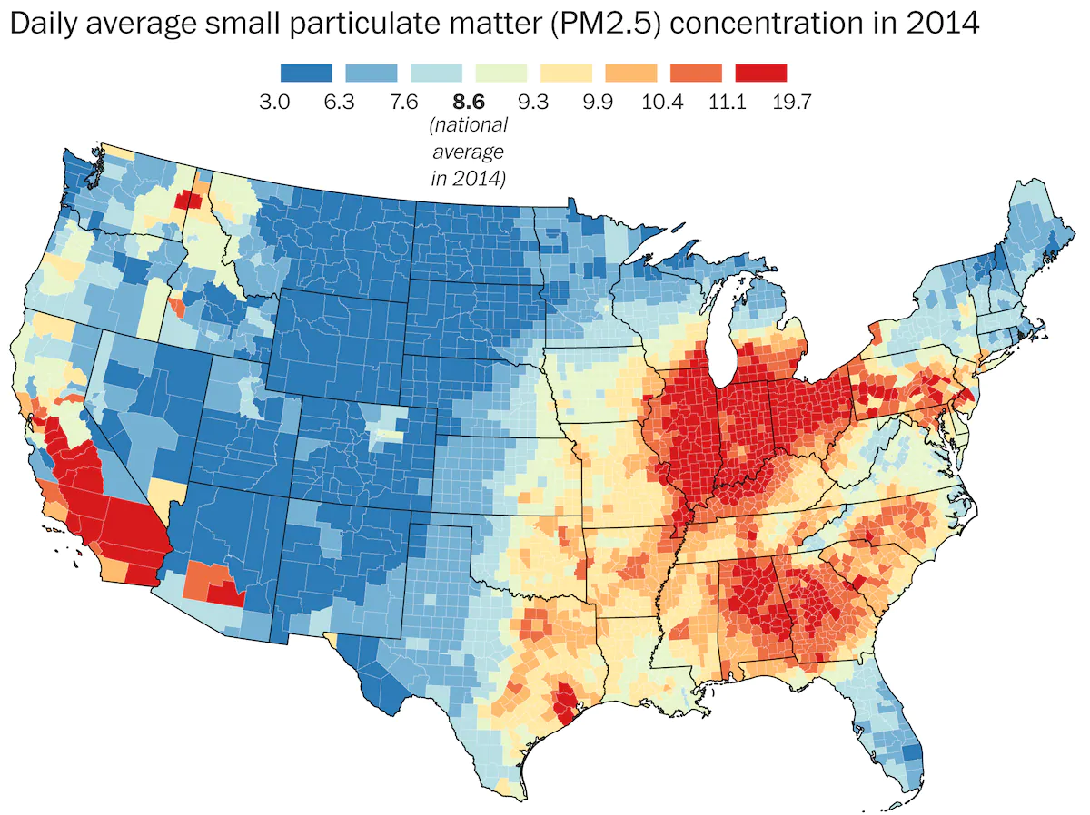
National burden of air pollution
Notes:
Consider air pollution
The effects of pollution are felt unequally
Pressing global health crisis

Slide 6
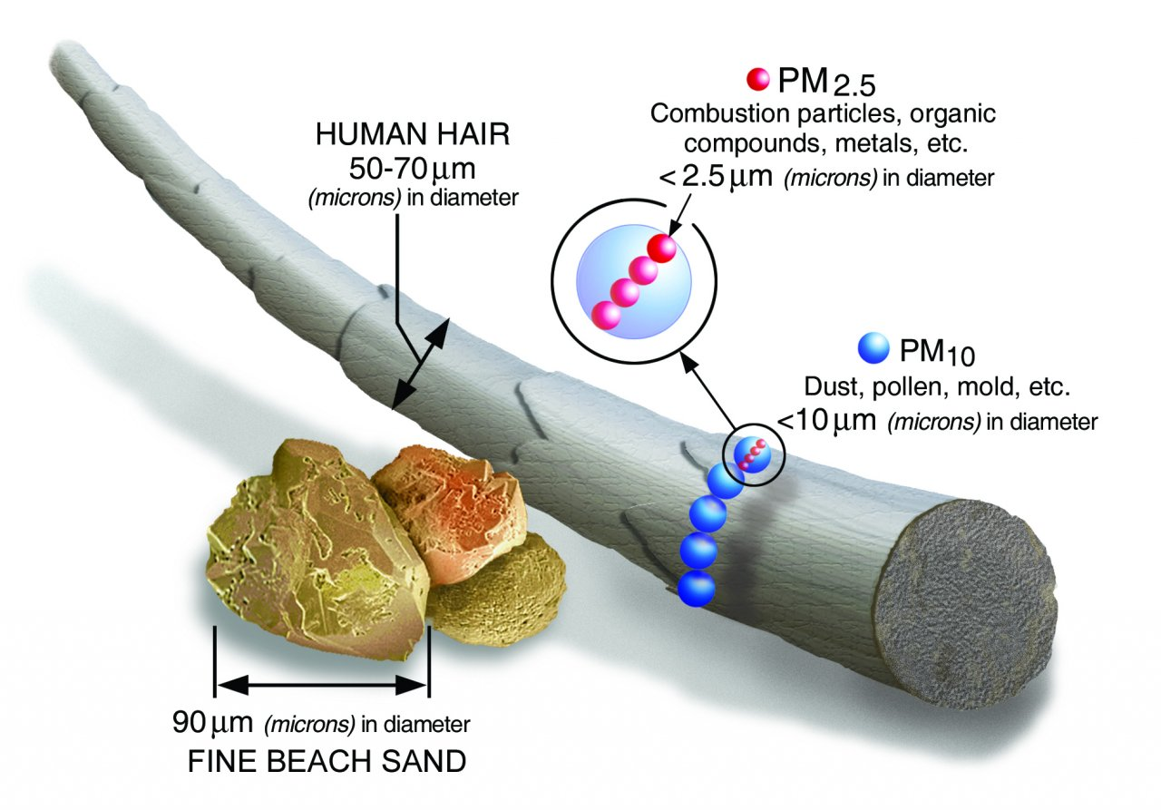
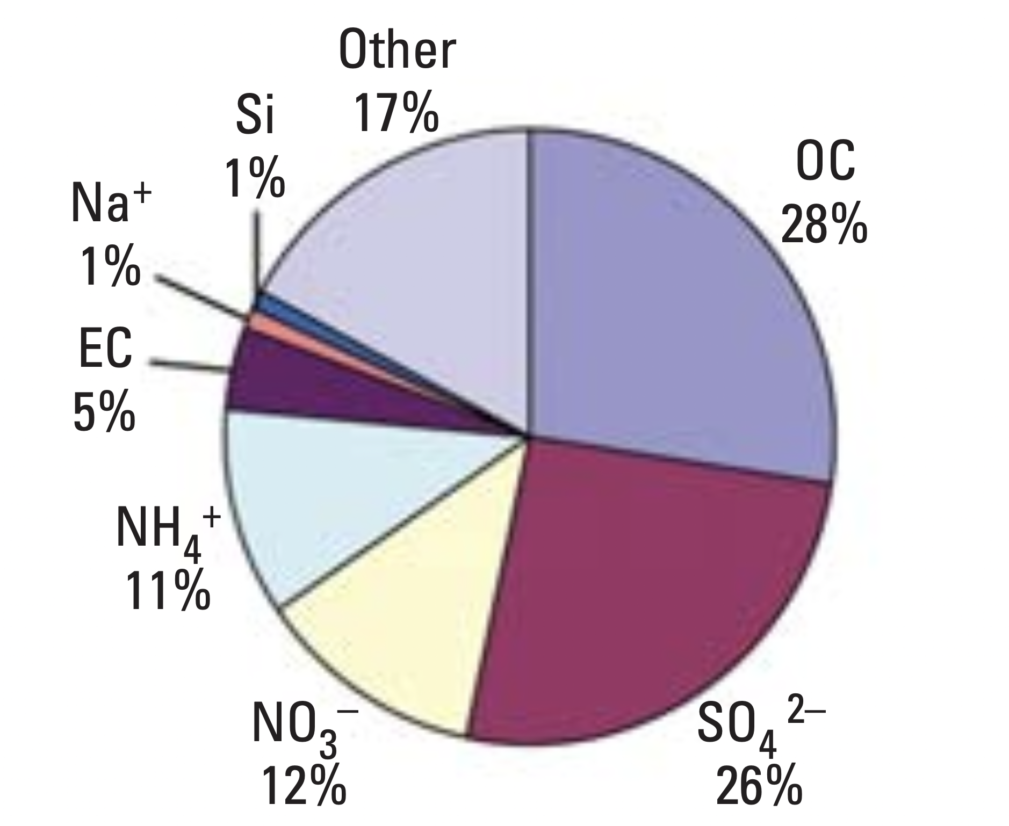
Air pollution is a chemical mixture
PM 2.5 components in the US
Notes:
In order to estimate the effects of air pollution, must deviate from the historical habit of trying to identify single sources for single effects
Much of environmental epidemiology has focused on single exposures
Broaden our view to joint effects of chemical mixtures
This view is more realistic
More protective of human health
Air pollution is a common example
Sometimes categorized as PM2.5
PM2.5 can include a complex mixture of other chemicals

Slide 7
Statistical challenges
High-dimensionality
Multicollinearity
Non-linear univariate effects
Non-additive interaction effects
→ the typical multiple linear regression framework is insufficient
Notes:
Barrier to widespread implementation are statistical challenges
Explain each
Under these conditions, MLR is insufficient
Has led to development of statistical techniques specifically designed to tackle these challenges
We are specifically interested in challenge of detecting non-additive interaction

Slide 8
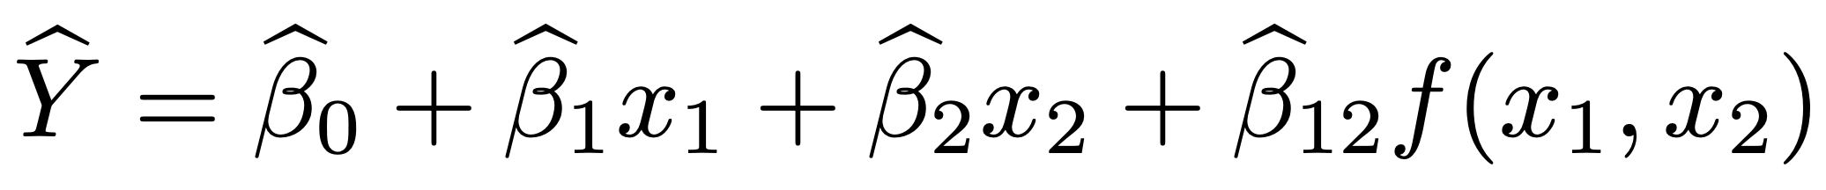
Non-additive interaction
Additive effect:
Non-additive interaction effect:
In a typical linear regression…
Notes:
Define additive effect vs. non-additive interaction
Extend to typical linear regression setting
Estimation is challenging
Most commonly, f is a multiplicative interaction, with x1 * x2, but can take on many different forms
Two-way interactions are most common, but three-way, four-way, etc. can also exist
Number quickly becomes intractable in high dimensional settings

Slide 9
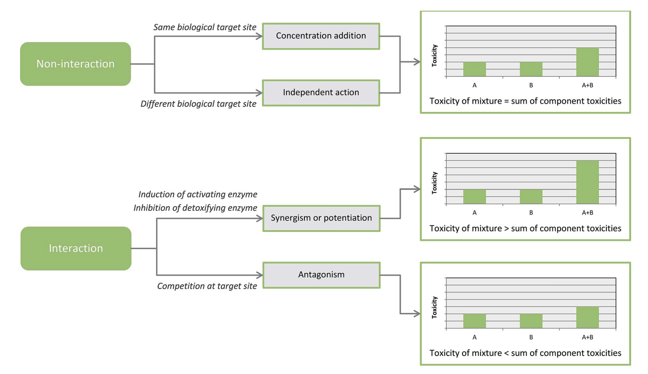
Mechanistic motivation
Notes:
Interaction between two chemicals
Can shed light on meaningful functional interaction between chemicals in a biological pathway
If we are in the synergistic category, and we did not capture the interaction, then we would underestimate the toxicity of a mixture

Slide 10
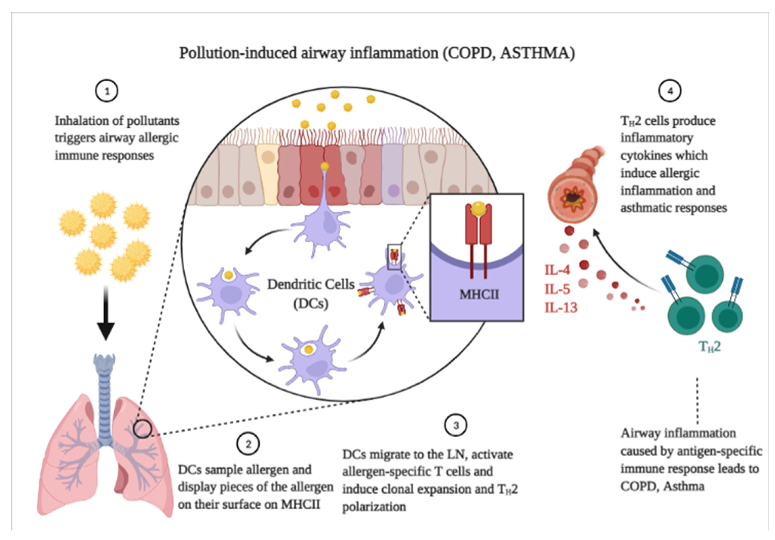
Mechanistic motivation
Notes:
Interaction between two chemicals
Can shed light on meaningful functional interaction between chemicals in a biological pathway
If we are in the synergistic category, and we did not capture the interaction, then we would underestimate the toxicity of a mixture

Slide 11
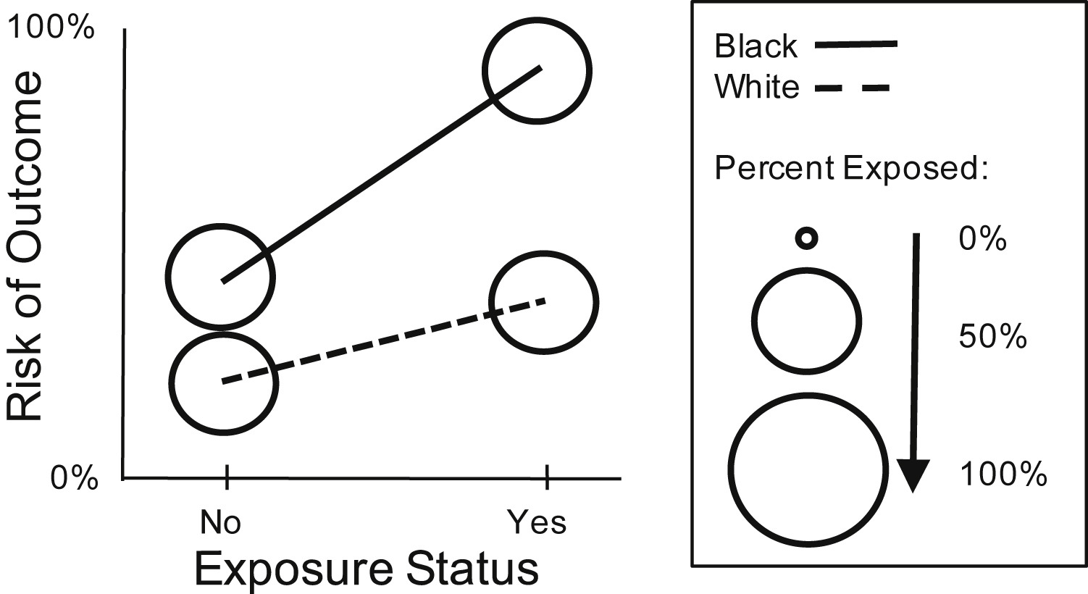
Public health motivation
Notes:
Interaction between covariate (from one of the other categories of the exposome) and chemical exposure
This is a simplistic scenario with binary variables
Illustrates that regulating an exposure can have a different magnitude of effect in different populations
Useful for public health practitioners when identifying the focus of regulatory legislation

Slide 12
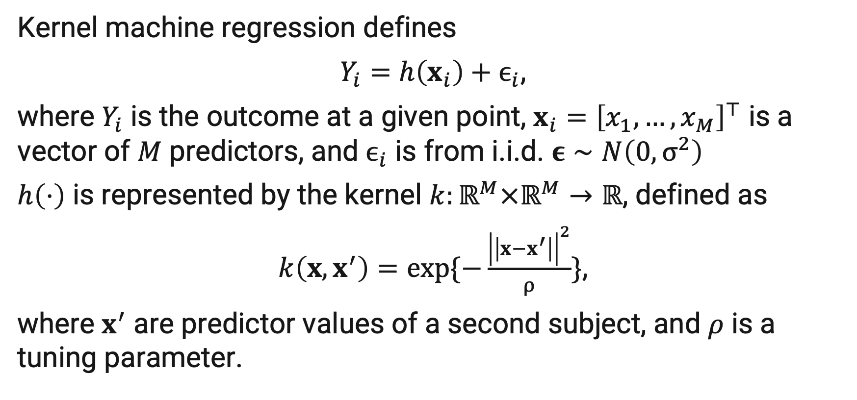
kernel machine regression
Kernel machine regression defines
$Y_{i}=h\left(x_{i}\right)+ϵ_{i}$,
where $Y_{i}$ is the outcome at a given point, $x_{i}={\left[x_{1},…,x_{M}\right]}^{⊤}$ is a vector of $M$ predictors, and $ϵ_{i}$ is from i.i.d. $ε∼N\left(0,σ^{2}\right)$
$h\left(⋅\right)$ is represented by the kernel $k:ℝ^{M}×ℝ^{M}→ℝ$, defined as
$k\left(x,x^{′}\right)=exp\{−\frac{{\left|\left|x−x^{′}\right|\right|}^{2}}{ρ}\}$,
where $x^{′}$ are predictor values of a second subject, and $ρ$ is a tuning parameter.

Slide 13
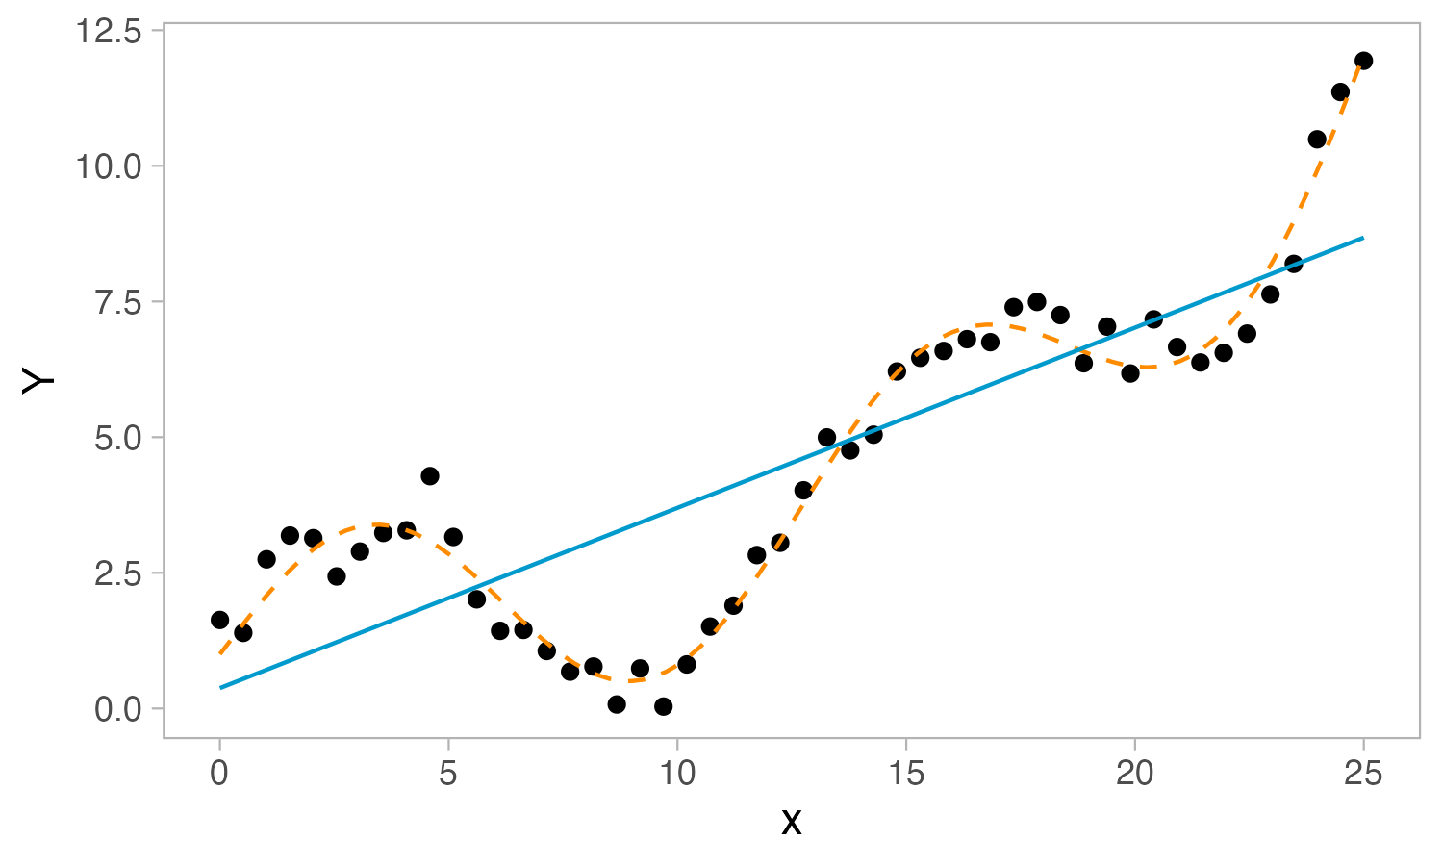
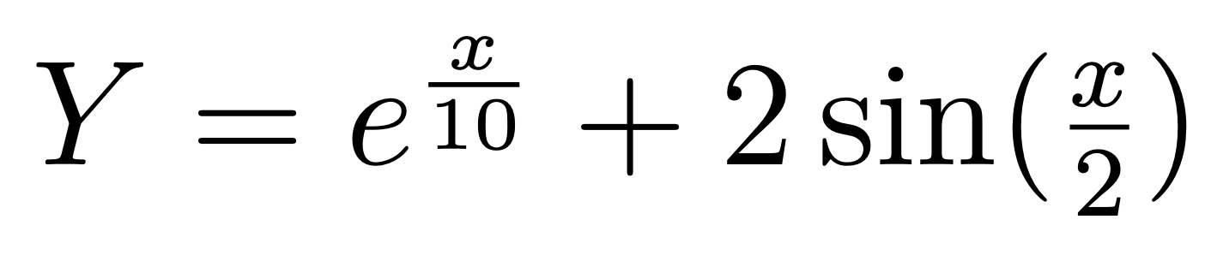
Toy example

Slide 14
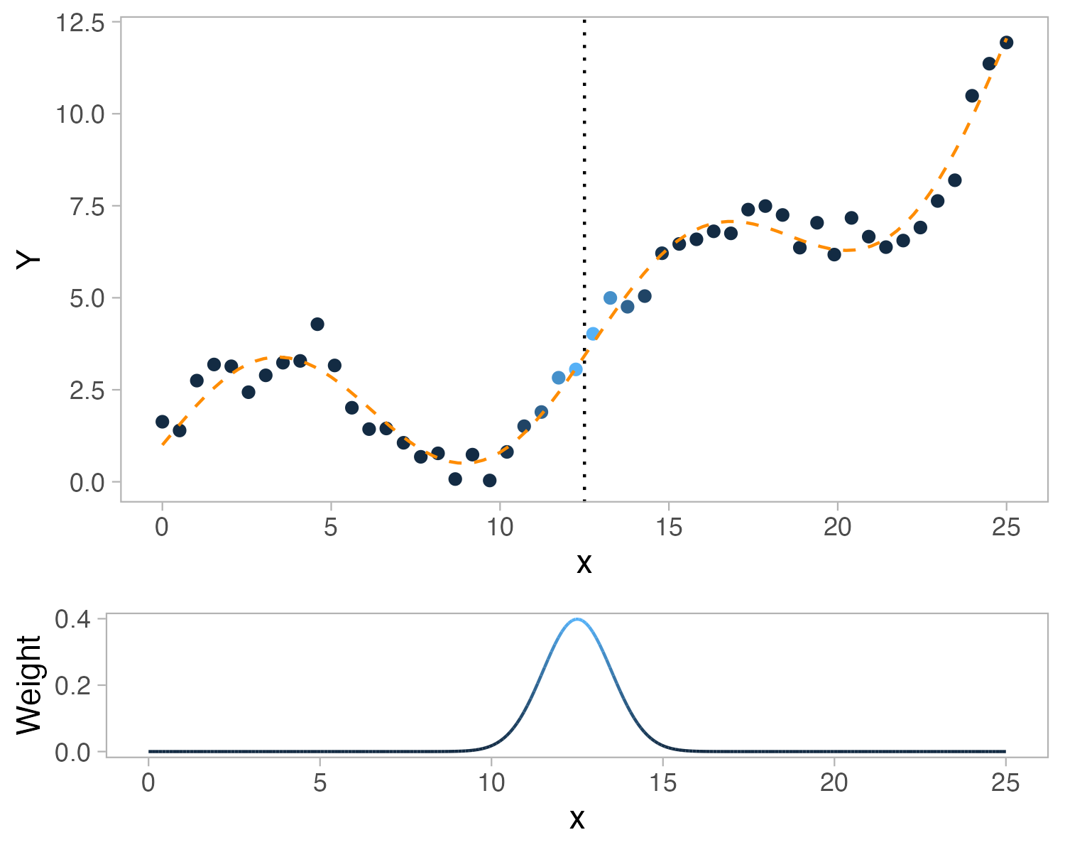
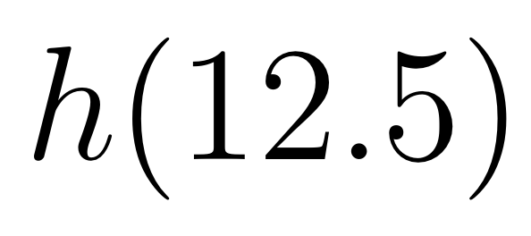
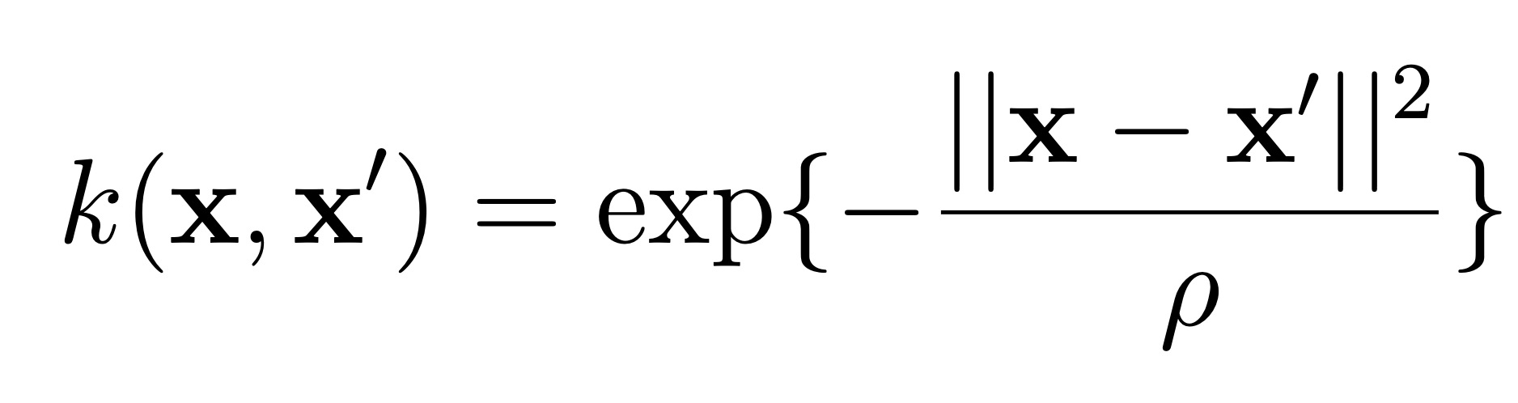
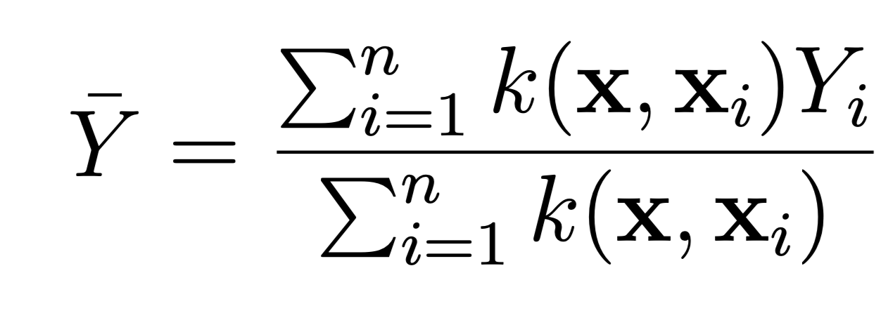
Toy example
Define a query point
Use the kernel to assign weights to neighboring points
Obtain estimate using a weighted average

Slide 15
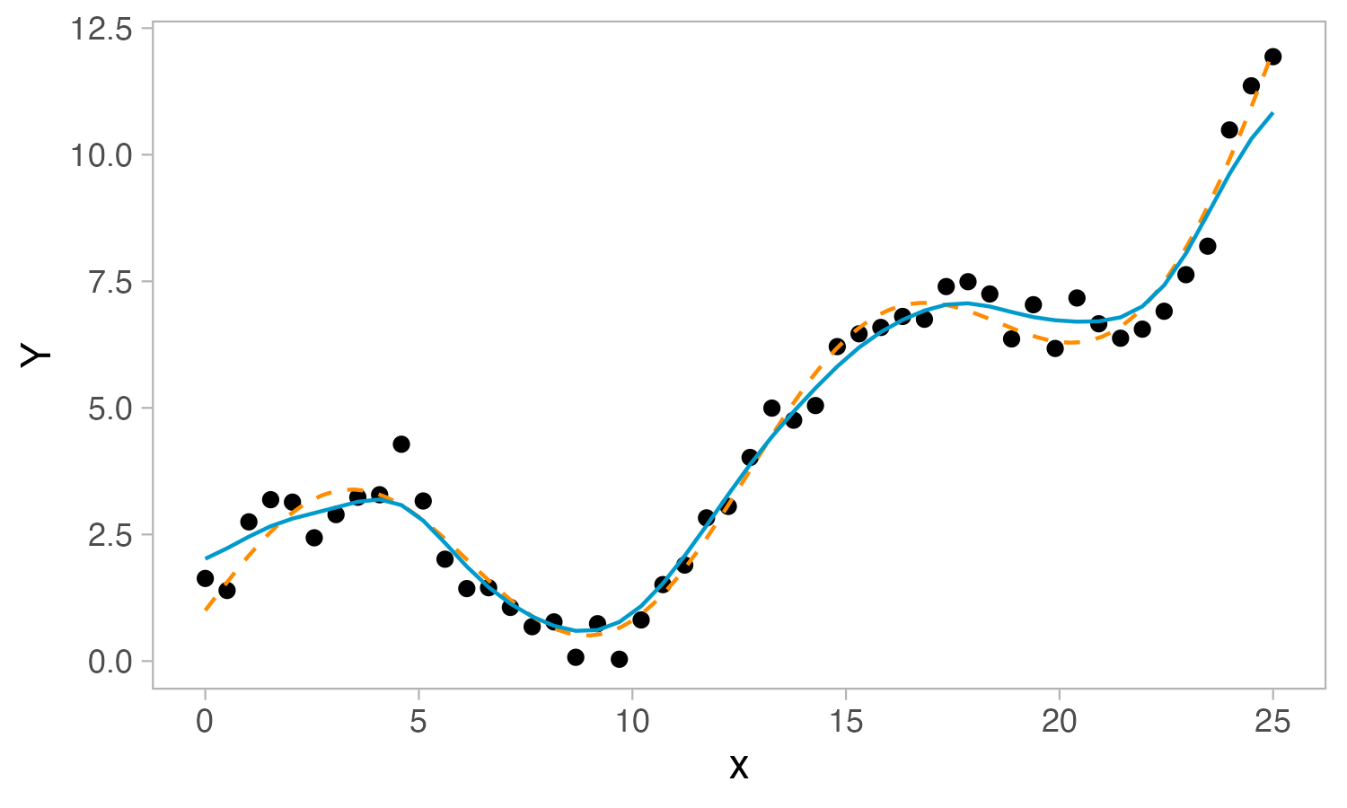
Toy example

Slide 16
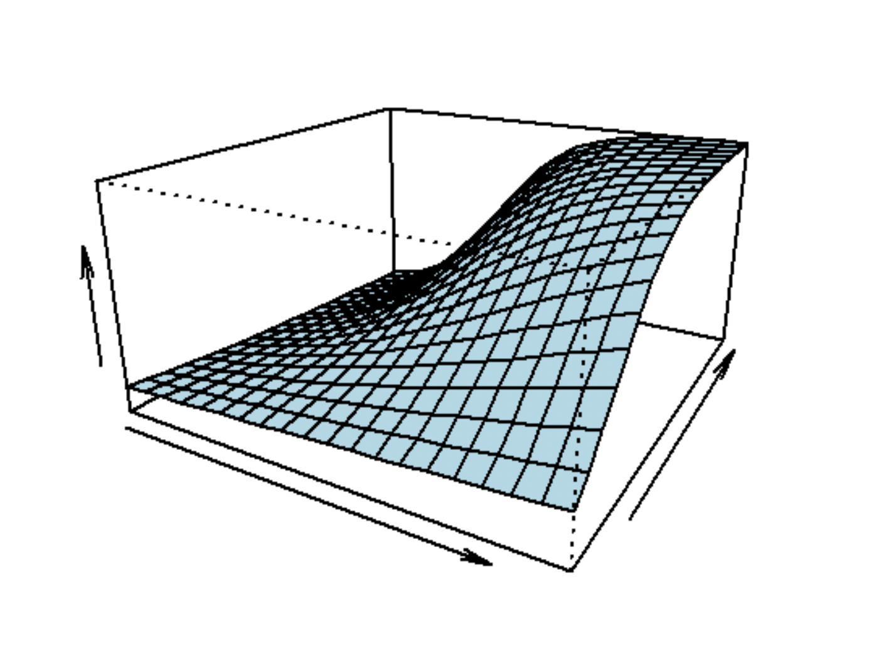
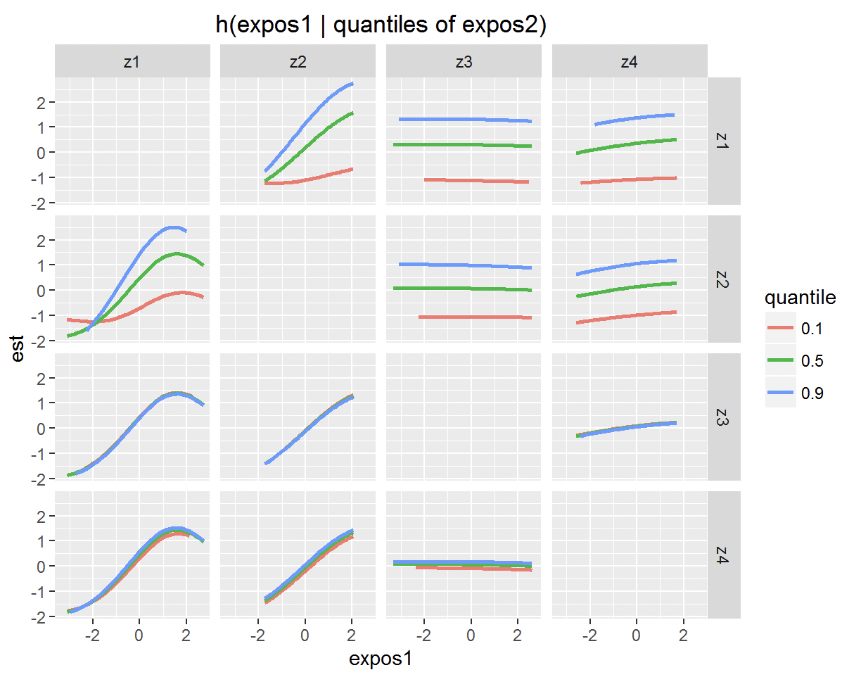
Bayesian Kernel Machine Regression (BKMR)
Allow flexible relationships between predictors and response
Nonparametric: no distributional assumptions
Detecting non-additive interactions
Notes:
Describe BKMR
Will compare to another Bayesian technique, Bayesian Semiparametric Regression
Note that there has yet to be a formal simulation study to assess the ability of these methods to provide inference on the presence and nature of non-additive interactions

Slide 17
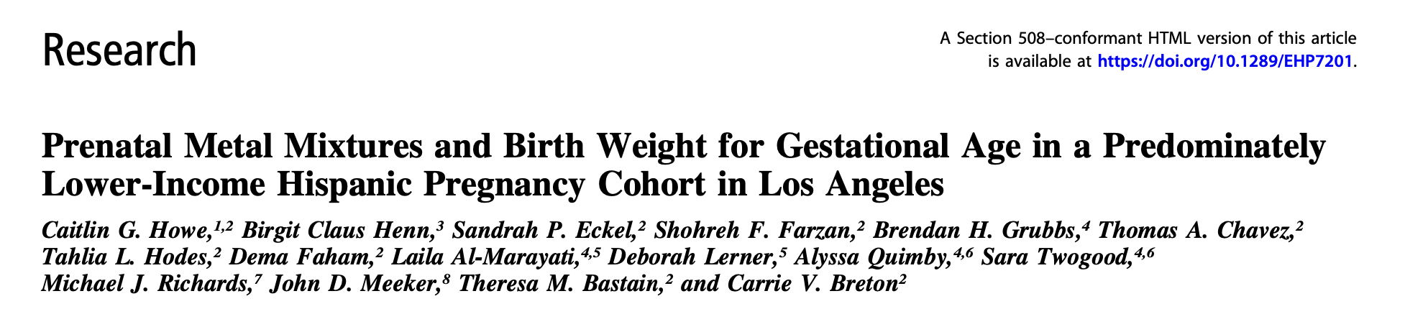
Simulation study
MADRES dataset:
Use real-world exposure data to generate outcome where…
Nature of interactions differ
Effect sizes differ
Notes:
Data from MADRES study
Past study used BKMR and BSR on association between exposure mixture and
Simulate outcome using exposure data as is from this study
Realistic correlation structure between predictors
Explain what we are varying in simulation

Slide 18
Simulation study
Methods:
Multiple linear regression (MLR) w/ additive effects only
MLR w/ true form of interactions specified
BKMR
Bayesian Semiparametric Regression (BSR)
→ provide guidance for the future study of complex interactions in exposure mixtures
Notes:
Comparing 4 methods
Goal is to benchmark the ability of Bayesian regression methods for conducting inference on non-additive interactions
Provide guidance for their future study

Slide 19
references
Antonelli, J., Mazumdar, M., Bellinger, D., Christiani, D., Wright, R., & Coull, B. (2020). Estimating the health effects of environmental mixtures using Bayesian semiparametric regression and sparsity inducing priors. The Annals of Applied Statistics, 14(1), 257–275. https://doi.org/10.1214/19-AOAS1307
Bell, M. L., Dominici, F., Ebisu, K., Zeger, S. L., & Samet, J. M. (2007). Spatial and Temporal Variation in PM2.5 Chemical Composition in the United States for Health Effects Studies. Environmental Health Perspectives, 115(7), 989–995. https://doi.org/10.1289/ehp.9621
Bobb, J. F., Valeri, L., Claus Henn, B., Christiani, D. C., Wright, R. O., Mazumdar, M., Godleski, J. J., & Coull, B. A. (2015). Bayesian kernel machine regression for estimating the health effects of multi-pollutant mixtures. Biostatistics, 16(3), 493–508. https://doi.org/10.1093/biostatistics/kxu058
Heys, K. A., Shore, R. F., Pereira, M. G., Jones, K. C., & Martin, F. L. (2016). Risk assessment of environmental mixture effects. RSC Advances, 6(53), 47844–47857. https://doi.org/10.1039/C6RA05406D
Howe, C. G., Claus, H. B., Eckel, S. P., Farzan, S. F., Grubbs, B. H., Chavez, T. A., Hodes, T. L., Faham, D., Al, -Marayati Laila, Lerner, D., Quimby, A., Twogood, S., Richards, M. J., Meeker, J. D., Bastain, T. M., & Breton, C. V. (2020). Prenatal Metal Mixtures and Birth Weight for Gestational Age in a Predominately Lower-Income Hispanic Pregnancy Cohort in Los Angeles. Environmental Health Perspectives, 128(11), 117001. https://doi.org/10.1289/EHP7201
Ritchie, H., & Roser, M. (2023). Air Pollution. Our World in Data. https://ourworldindata.org/air-pollution
Steffen, W., Grinevald, J., Crutzen, P., & McNeill, J. (2011). The Anthropocene: Conceptual and historical perspectives. Philosophical Transactions of the Royal Society A: Mathematical, Physical and Engineering Sciences, 369(1938), 842–867. https://doi.org/10.1098/rsta.2010.0327
US EPA, O. (2016, April 19). Particulate Matter (PM) Basics [Overviews and Factsheets]. https://www.epa.gov/pm-pollution/particulate-matter-pm-basics
Vermeulen, R., Schymanski, E. L., Barabási, A.-L., & Miller, G. W. (2020). The exposome and health: Where chemistry meets biology. Science, 367(6476), 392–396. https://doi.org/10.1126/science.aay3164
Yu, L., Liu, W., Wang, X., Ye, Z., Tan, Q., Qiu, W., Nie, X., Li, M., Wang, B., & Chen, W. (2022). A review of practical statistical methods used in epidemiological studies to estimate the health effects of multi-pollutant mixture. Environmental Pollution, 306, 119356. https://doi.org/10.1016/j.envpol.2022.119356

Slide 20
Spline regression

Slide 21
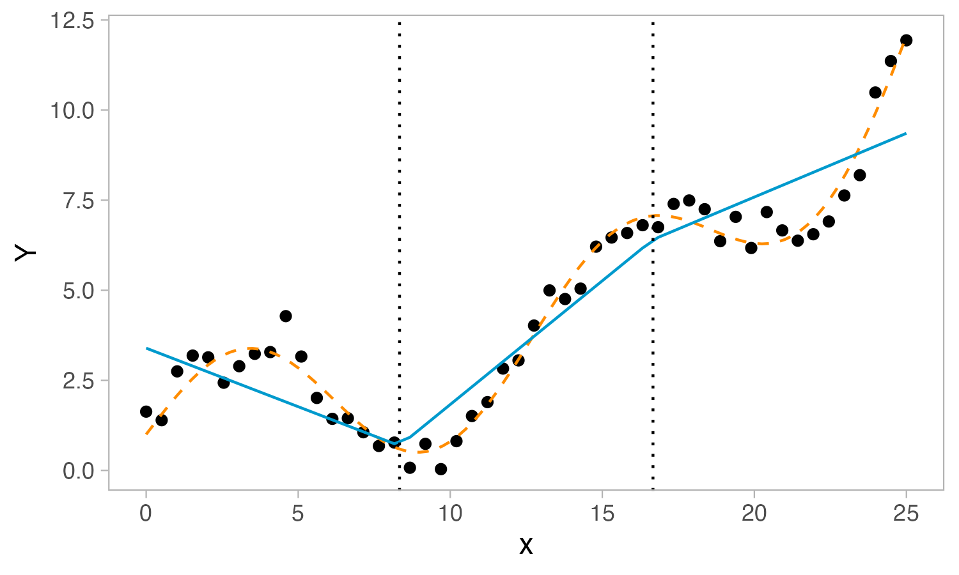
Toy example

Slide 22
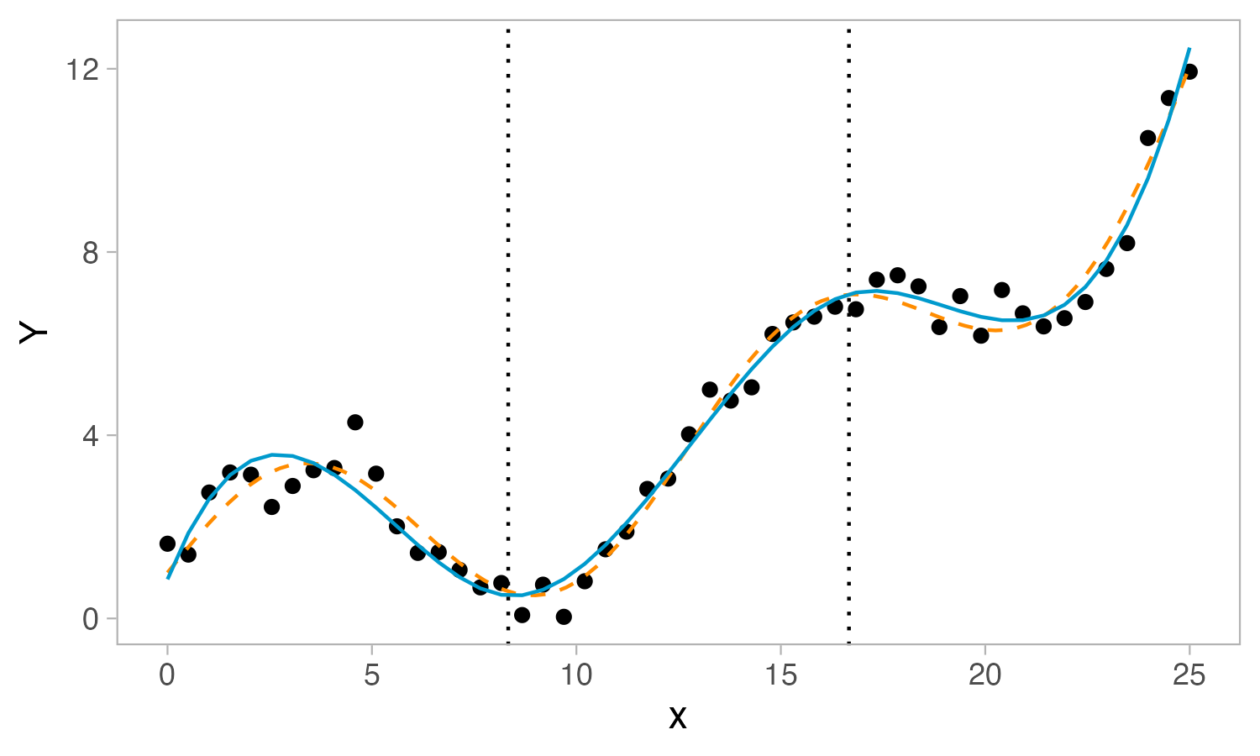
Toy example

